Slide 1

haryoka molecular sciences
We use the power of chemistry respon­sibly to produce molecules and materials that improve life sustainably
Science of Sustainability TM

Slide 2
Tabs for Webpage
About us/ Home : Slide 4
Technologies – Slides 5-8
Sustainability: Slide 9 + Use a good nature photo
blogs: Leave editable options and inform us how to edit the pages
Will write a blog by Aug 15th.
Contact us – info@haryoka.com

Slide 3
Product Vision:
Sustainable additives for high volume chemicals – Static dissipation, surfactants etc.
Atom efficiency – For both manufacturing and end use.
Sustainable chemistry for existing non-biodegradable materials – To make non-biodegradable common plastics biodegradable.
Going beyond carbon credits – Creating new value-added products while completing the carbon cycle to reach our goal of zero-emission in an economic way.

Slide 4
About us
haryoka molecular sciences
Science of Sustainability TM
hari-ōka (green-home in Sanskrit) is The Chemical Company for the future.
Chemistry plays an indispensable role in shaping industries, fueling technological advancements, and improving various aspects of our lives, but if we do not do it right, it can have disastrous consequences.
At haryoka, we create green and sustainable chemistry, free from the environmental problems that indiscriminate use of chemical technology has created over the past century. We offer superior, sustainable chemicals through eco-friendly manufacturing processes and technologies.
Our goal is to develop next-generation chemical technology where circularity of products and processes will bring back the verdure and vibrancy our planet has lost, all without compromising on human comfort and economic viability.

Slide 5
Technologies
where haryoka can make a difference right now
1
monomers that make existing polymers biodegradable and recyclable
2
sustainable fluoropolymers and alternatives
3
biodegradable and functional chemicals and materials from CO₂

Slide 6

haryoka molecular sciences
Science of Sustainability TM
We own proprietary technology for the large-scale synthesis of cyclic ketene acetal monomers that enable the production of a biodegradable version of existing plastics and care chemicals.
Using these monomers and our advanced polymer reaction engineering approach, we can solve your non-biodegradability problems in existing polymers.
We develop our monomers from natural resources in a carbon-neutral way for the sustainability of our planet.
methods to make existing polymers biodegradable and recyclable

Slide 7

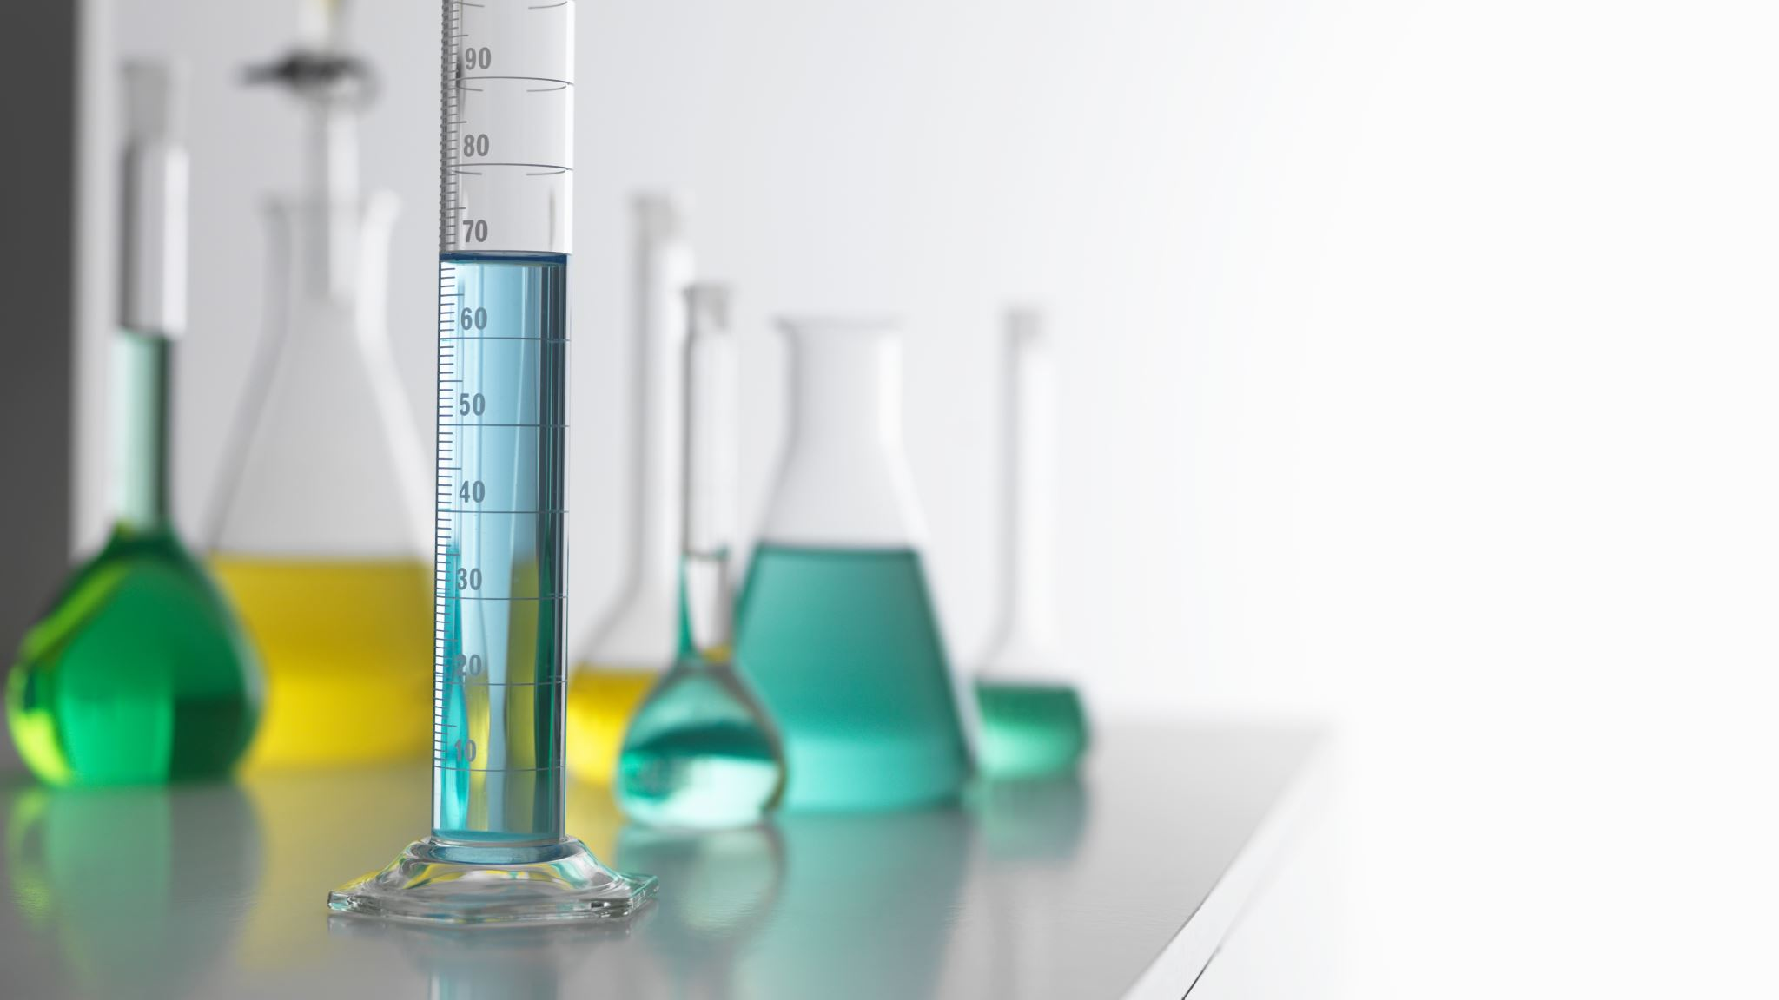

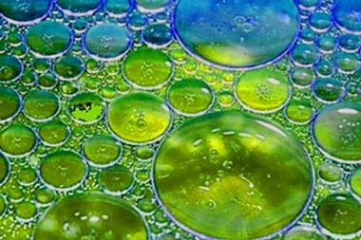
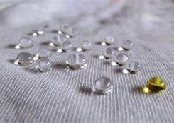
haryoka molecular sciences
Science of Sustainability TM
Our proprietary Haryostat-C4 technology is a first-generation nonfluorine alternative which is an ideal additive for manufacturing, transportation, health care and electronic materials with outstanding performance and stability. While Haryostat-C4 has comparable low surface resistivity and nonabrasive properties to current fluoropolymers, it is sustainable, non-toxic and even comes with a lower production cost and price than current fluoropolymers due to the green chemistry principles that have been applied in creating and scaling up these alternatives.
Ionic Liquids
Surfactants
Ultra-thin Coatings

Slide 8

haryoka molecular sciences
Science of Sustainability TM
Greenhouse gas capture/sequestration
haryoka’s proprietary technology is creating next-generation industrial chemicals straight from carbon dioxide and bioderived small molecules without high temperature and pressure. This technology platform enables our industrial partners to earn carbon credits and contribute to sustainability while generating revenue through carbon capture. Currently we are optimizing the following technologies to scale to offer to industry:
next-generation industrial solvents
next-generation monomers
biodegradable polymers with high performance
biodegradable and functional chemicals and materials from CO₂

Slide 9
Sustainability
Sustainability lies at the very core of haryoka’s business philosophy. With an unwavering commitment to environmental responsibility, we take pride in placing the sustainability over profit margins. We are proud to lead the charge in creating a greener and more sustainable future for our planet with our comprehensive approach that spans across every aspect of our operations, from sourcing raw materials to the development of groundbreaking, eco-friendly technologies.
Through continuous research and innovation, we are working towards reducing the global carbon footprint, promoting zero-waste initiatives, and optimizing resource consumption. Our dedication to sustainability is ready to extend beyond our own practices and we actively seek out collaborations with communities, educational organizations, NGOs, and industry partners to foster positive connections that will create sustainable societies and ecosystems for generations to come.
For haryoka sustainability is not an option; it is our responsibility to humanity and the planet and we are fully committed to making a lasting difference.

Slide 10
haryoka molecular sciences
We use the power of chemistry respon­sibly to produce molecules and materials that improves life sustainably
Science of Sustainability TM
For more information e-mail to info@haryoka.com

Slide 11
Model pages
https://www.seedsprint.com/5-green-chemistry-startups-profiled-on-seedsprint/
https://aequorinc.com/
https://www.ecoviarenewables.com/
https://innoverda.com/
https://www.kalioninc.com/
https://www.naturecoatingsinc.com/

